Slide 1
Detection Suite: toolbox to evaluate object detection solutions based on NN
Sergio Paniego Blanco
MUVA, URJC, 3-3-2020

Slide 2


PRESENTATION
URJC student.
JdeRobot member.
GSoC student developer (2018) and mentor (2019).
AI learner.
github.com/JdeRobot/DetectionSuite
jderobot.github.io/DetectionSuite/

Slide 3
OBJECTIVES
Enumerate the vast amount of options in DL and the fast-paced development across the field.
Introduce Detection Suite toolbox.
Problems and solutions in a DL project.
Provide real-world experiment.

Slide 4
INDEX
INTRODUCTION
STATE OF THE ART
DETECTIONSUITE TOOLBOX
EXPERIMENTS
CONCLUSIONS

Slide 5
INDEX
INTRODUCTION
STATE OF THE ART
DETECTIONSUITE TOOLBOX
EXPERIMENTS
CONCLUSIONS

Slide 6
INTRODUCTION
Toolbox for object detection (classification + location).
Open Source project
Simplify development and testing of solutions based on object detection.
Trial and error in deep learning networks development.
Need for objective comparison between different approaches.

Slide 7
INTRODUCTION
2 times accepted project in GSoC with JdeRobot:
Vinay Sharma (2018).
Jeevan Kumar (2019).
Research paper:
Vinay Sharma .
José María Cañas.
International collaboration.

Slide 8
INDEX
INTRODUCTION
STATE OF THE ART
DETECTIONSUITE TOOLBOX
EXPERIMENTS
CONCLUSIONS

Slide 9
STATE OF THE ART
DATASETS
FRAMEWORKS
NETWORK MODELS

Slide 10

DATASETS
IMAGENET.
Dataset and annual competition.
ImageNet Large Scale Visual Recognition Challenge (ILSVRC).
1000 object classes (200 in object detection).
1.5M images.
Milestones: AlexNet (A. Krizhevsky, et al. 2012), ResNet (K. He, et al. 2015).
O. Russakovsky, J. Deng, H. Su, J. Krause, S. Satheesh, S. Ma, Z. Huang, A. Karpathy, A. Khosla, M. Bernstein, A. C. Berg & L. Fei-Fei . ImageNet Large Scale Visual Recognition Challenge. IJCV, 115. . Springer, 2015, pp. 211-252.

Slide 11

DATASETS
COCO DATASET (Tsung-Yi Lin et al. 2015).
Designed for object detection and segmentation.
~90 categories.
Detection of objects in natural situations .
~330.000 images. 2.500.000 labelled instances.
Fewer categories, but more instances per category.
Majority of non-iconic images.
Flickr images
minival
Sergio Paniego Blanco
T.-Y. Lin, M. Maire, S. Belongie, J. Hays, P. Perona, D. Ramanan, P. Dollar, and C. L. Zitnick. Microsoft COCO: Common objects in context. European conference on computer vision. Springer, 2014, pp. 740-755.

Slide 12

DATASETS
PASCAL VOC challenge.
Dataset and annual competition.
~20.000 images.
20 object categories.
~25.000 object instances.
Flickr images.
M. Everingham, L. V. Gool, C. K. I. Williams, J. Winn, A. Zisserman. The Pascal Visual Object Classes (VOC) Challenge. International Journal of Computer Vision, 88. . Springer, 2010, pp. 303-338.

Slide 13
DATASETS
PRINCETON RGB DATASET.
~10000 images.
Focused on tracking.
SPINELLO DATASET.
~3000 images captured using Kinetic.
Focused on person detection and tracking.

Slide 14



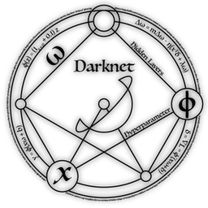

FRAMEWORKS
Tensorflow.
Keras.
Darknet (J. Redmon).
Pytorch.
Caffe.
…

Slide 15
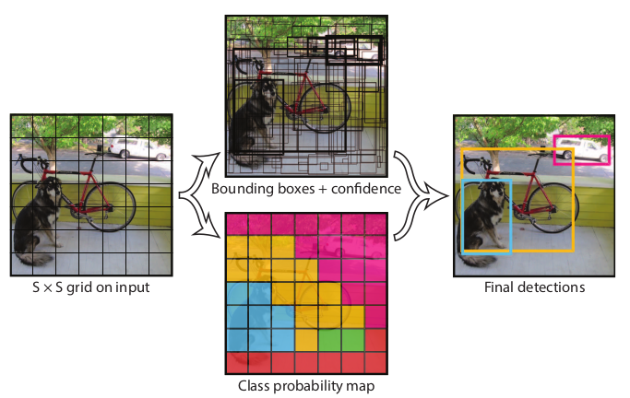
NETWORK MODELS
Vast amount of network models. Different approaches to address the problem.
FASTER REGIONAL-CNN (S. Ren et al. 2016).
Regional proposal network (RPN).
Improve over R-CNN and Fast R-CNN.
SINGLE SHOT MULTIBOX DETECTOR (SSD) (Liu et al. 2016).
Detections can be generated in a single forward propagation.
YOU ONLY LOOK ONCE (Redmon et al. 2016).
Sees the entire image.
YOLO v3.

Slide 16
INDEX
INTRODUCTION
STATE OF THE ART
DETECTIONSUITE TOOLBOX
EXPERIMENTS
CONCLUSIONS

Slide 17
DETECTION SUITE
Toolbox to work with object detection NN and datasets.
Pretrain your model, test it with Detection Suite.
GUI or CLI, with configuration file.
Broad framework and datasets support.
Linux and macOS support.
Written mainly in C++ and Python.
Notes:
Support until YOLO v2. TF 2.1 …

Slide 18
TOOLBOX
VIEWER
DETECTOR
EVALUATOR
DEPLOYER
COMMAND LINE INTERFACE (AUTO EVALUATOR)
CONVERTER
LABELLING
ROS NODE

Slide 19
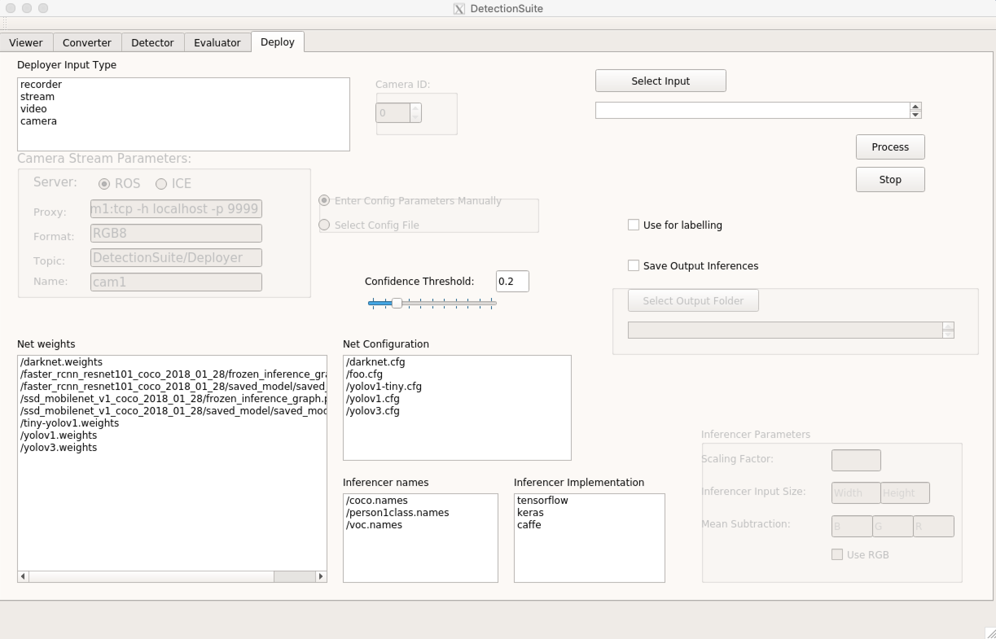
DETECTION SUITE

Slide 20
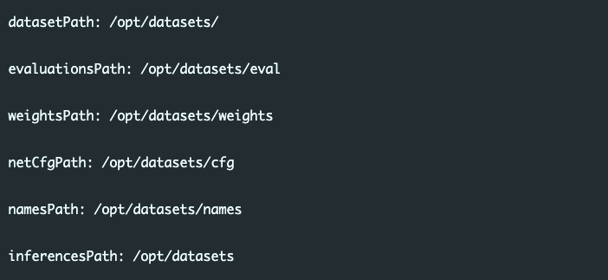
CONFIG FILE
Two types of config files.
Config file example (.yml):

Slide 21
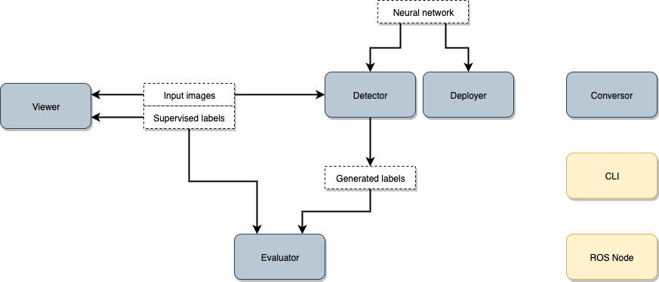
GENERAL ARCHITECTURE
Main (blue) and additional (yellow) modules.

Slide 22
DETECTION SUITE
Each tool has its own tab.
Separated modules.
GPU support.
Set of resources available in the webpage:
Class names.
Model zoo.

Slide 23
FRAMEWORKS SUPPORT
Dependency with frameworks installed.
Framework evaluators: connection with target DL framework.
Each framework neural network format.
Dependency with configuration files.

Slide 24
DATASETS SUPPORT
Dataset readers and writers for every option supported.
Own dataset format.
COCO dataset format vs. Pascal VOC dataset format.
JSON file with annotations in COCO.
Divided in:
Info.
Licenses.
Categories.
Images.
Annotations.
XML file for each image in Pascal VOC.

Slide 25
TOOLBOX
VIEWER
DETECTOR
EVALUATOR
DEPLOYER
COMMAND LINE INTERFACE (AUTOEVALUATOR)
CONVERTER
LABELLING
ROS NODE

Slide 26
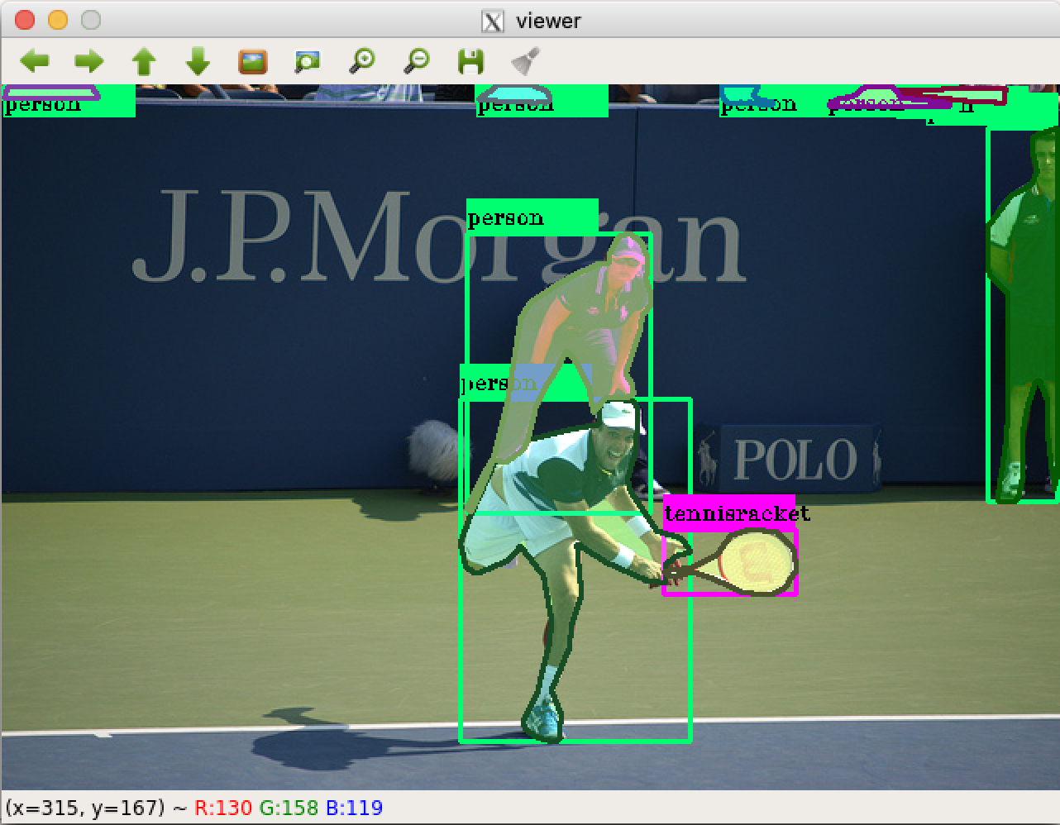
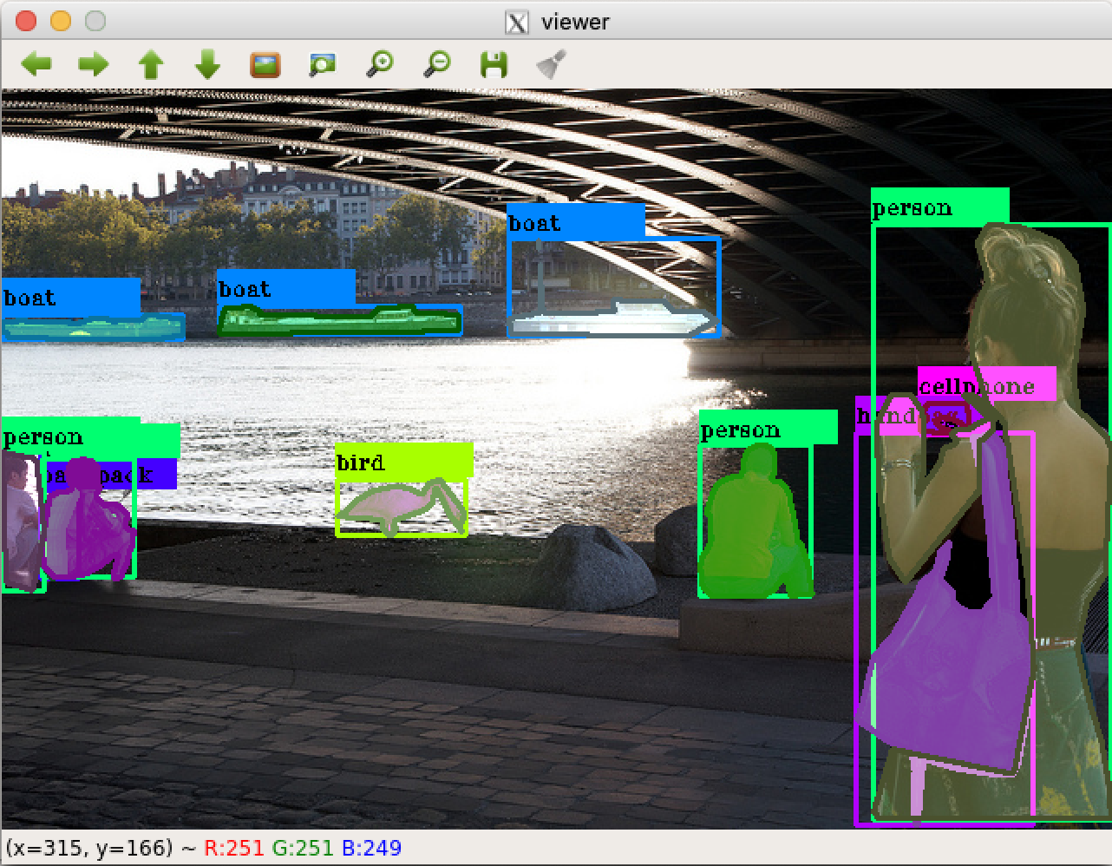
VIEWER
Read annotations files and displays it.
Provides general statistics about the dataset: number of elements/class, total images, total samples.
Supports previously presented datasets.
CLI available.

Slide 27
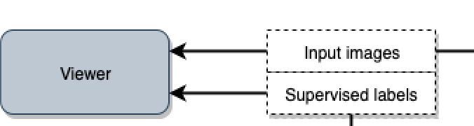
VIEWER

Slide 28

VIEWER
https://www.youtube.com/watch?v=VMd6ve8brTE

Slide 29
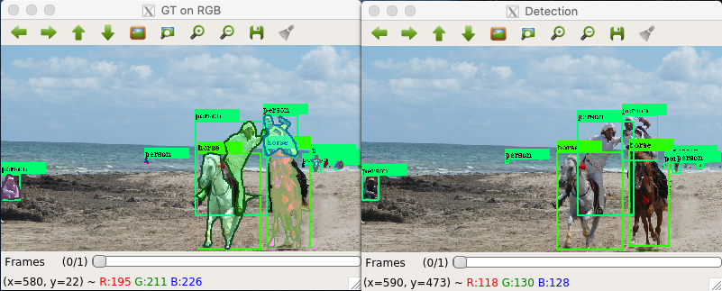
DETECTOR
Runs detections over an input dataset and generated labelled dataset.
Needs a pretrained neural network.
Command line available.
GT view and detection view.

Slide 30
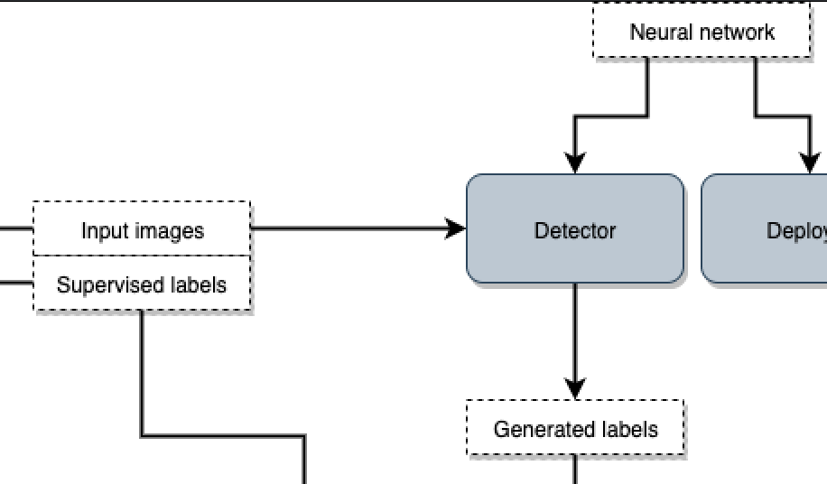
DETECTOR

Slide 31

DETECTOR
https://www.youtube.com/watch?v=DpK5gqwoSBc

Slide 32
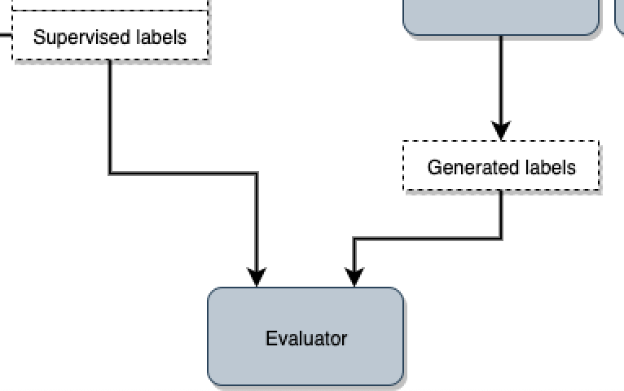
EVALUATOR
2 input datasets: ground truth and detections.
Compares then using metrics.
mAP, mAR.
IoU = 0.5:0.95.
Mean inference time.
Generates a .csv file with the metrics for evaluated datasets.

Slide 33
EVALUATOR
https://www.youtube.com/watch?v=Vk6Hdv6mRZk

Slide 34
EVALUATOR
Example evaluation_results.csv over COCO minival using COCO pretrained SSD NN.

Slide 35
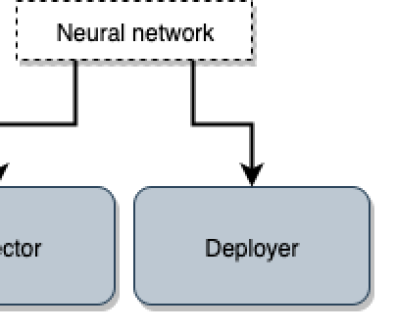
DEPLOYER
Accepts different input sources:
Video file.
Camera stream.
Neural network model needed.
Class names.
Real time processing.
Only GUI.
Detection threshold.
Save inferences → create datasets.
Labelling.

Slide 36
DEPLOYER
https://www.youtube.com/watch?v=xX2c_Trp9qY

Slide 37
LABELLING
Playback functionality.
Adjustable bounding boxes.
Change class and add detections.

Slide 38
LABELLING
https://www.youtube.com/watch?v=PPNjKML9vUw

Slide 39
CONVERTER
Converts between dataset formats.
CLI available.
Map classes names between datasets.
Split into train/test set.
Own dataset.

Slide 40
CONVERTER
https://www.youtube.com/watch?v=bOjt0v_h640

Slide 41
CLI
Many of the different tools are available as command line applications.
Only a config file is needed.
AutoEvaluator tool.
Multiple datasets and frameworks evaluation at the same time.
Generates a csv with the results.

Slide 42
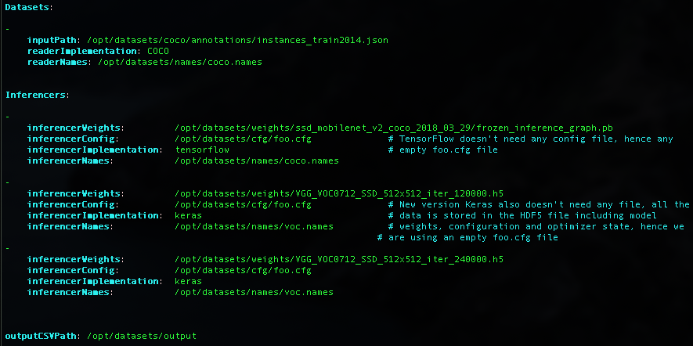
CLI

Slide 43
ROS NODE
Real time inference over an image stream.
Subscribe to a ROS topic.
Configuration file.

Slide 44
ROS NODE
https://www.youtube.com/watch?v=xvPaFZD5EoY

Slide 45

DETECTION SUITE WORKFLOW
minival
evaluation_results.csv

Slide 46
INDEX
INTRODUCTION
STATE OF THE ART
DETECTIONSUITE TOOLBOX
EXPERIMENTS
CONCLUSIONS

Slide 47
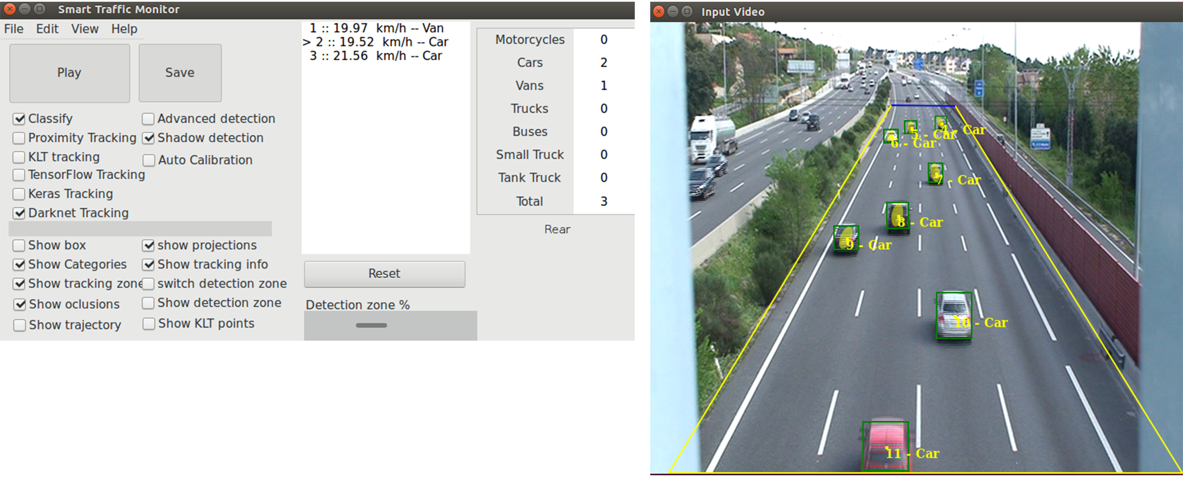
SMART TRAFFIC SENSOR
Monitors road traffic using computer vision.

Slide 48
SMART TRAFFIC SENSOR
Evolution of Traffic Monitor project (classical CV techniques).
New version with state of the art deep learning techniques.
Several neural networks trained (different frameworks).
Compared using Detection Suite.
Detection and classification of road traffic.
Own created dataset.
Pretrained network vs. pretrained + trained using the dataset.
The best performing network is YOLOv3.
Better performance and higher mean inference time (more complex and deeper network).
J.F. Martínez. Monitorización Visual de Tráfico Rodado usando Deep Learning. Master’s thesis. Universidad Rey Juan Carlos, Madrid, Spain. 2019.

Slide 49
SMART TRAFFIC SENSOR
Evaluation over created STS dataset
Network | mAP (Overall)(IoU=0.5:0.95) | mAR (Overall)(IoU=0.5:0.95) | Mean inference time (ms)
Keras SSD VVG-16 | 0 | 0 | 0
Yolo v3 | 0 | 0 | 14162
TF SSD MobileNet v2 | 0.0035 | 0.0373 | 142
Keras SSD VVG-16 STS trained | 0.6709 | 0.7082 | 3194
Yolo v3 STS trained | 0.8641 | 0.9385 | 16894
TF SSD MobileNet v2 STS trained | 0.3283 | 0.4231 | 76

Slide 50
SMART TRAFFIC SENSOR
Comparison of systems in high-quality videos using Detection Suite.
System type | mAP | mAR
Smart Traffic Sensor | 0.8926 | 0.9009
Traffic Monitor | 0.4374 | 0.5940
Best performing NN (YOLO v3) | 0.8316 | 0.8966

Slide 51
INDEX
INTRODUCTION
STATE OF THE ART
DETECTIONSUITE TOOLBOX
EXPERIMENTS
CONCLUSIONS

Slide 52
CONCLUSIONS
Set of tools. Modulable.
CLI and GUI.
Real life application.
Extensible
In development (pytorch support, YOLOv3…).
Accepting new contributors to projects and org!

Slide 53
QUESTIONS?
@sergiopaniego
sergiopaniegoblanco@gmail.com
https://github.com/JdeRobot/DetectionSuite
https://jderobot.github.io/DetectionSuite/
Presentation template: slidescarnival.com

